Slide 1


Raspberry 101

Slide 2
Raspberry Pi & developping for ARM boards
Can I eat it? or what is a Raspberry Pi?
SSH and VNC
Snake on a Pi? What is Python and why I should bother learning it
A few examples…
Python Charming

Slide 3
Can I eat it? or what is a Raspberry Pi?
History
Hardware
A few alternatives
First prototypes in 2006
Developped in Cambridge
Inspired by the BBC micro
Make computers available for the masses
Designed with a max 35$ BOM
Raspberry Pi 3b+ & Pi 0 WH released in 2018
10millions+ sold
Many OS: Raspbian, Linux, Windows IOT
ARM Chip (SOC)
La frite
Odroid-C2
Orange Pi+ Asus Tinker S
3b+ | Zero WH
1,4GHz, quad | 1GHz
1Go | 512 Mo
1 micro-USB 1 mini-HDMI
Wifi 802.11ac, BT, Ethernet 300 | Wifi, Bt

Slide 4
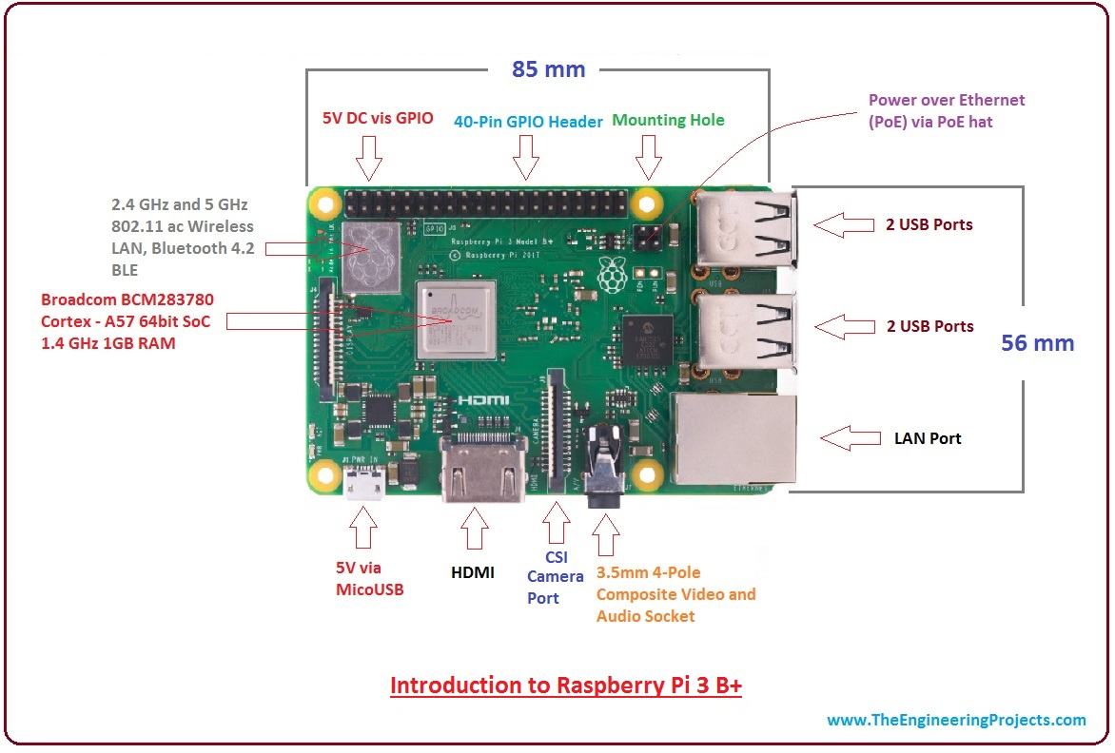

Slide 5
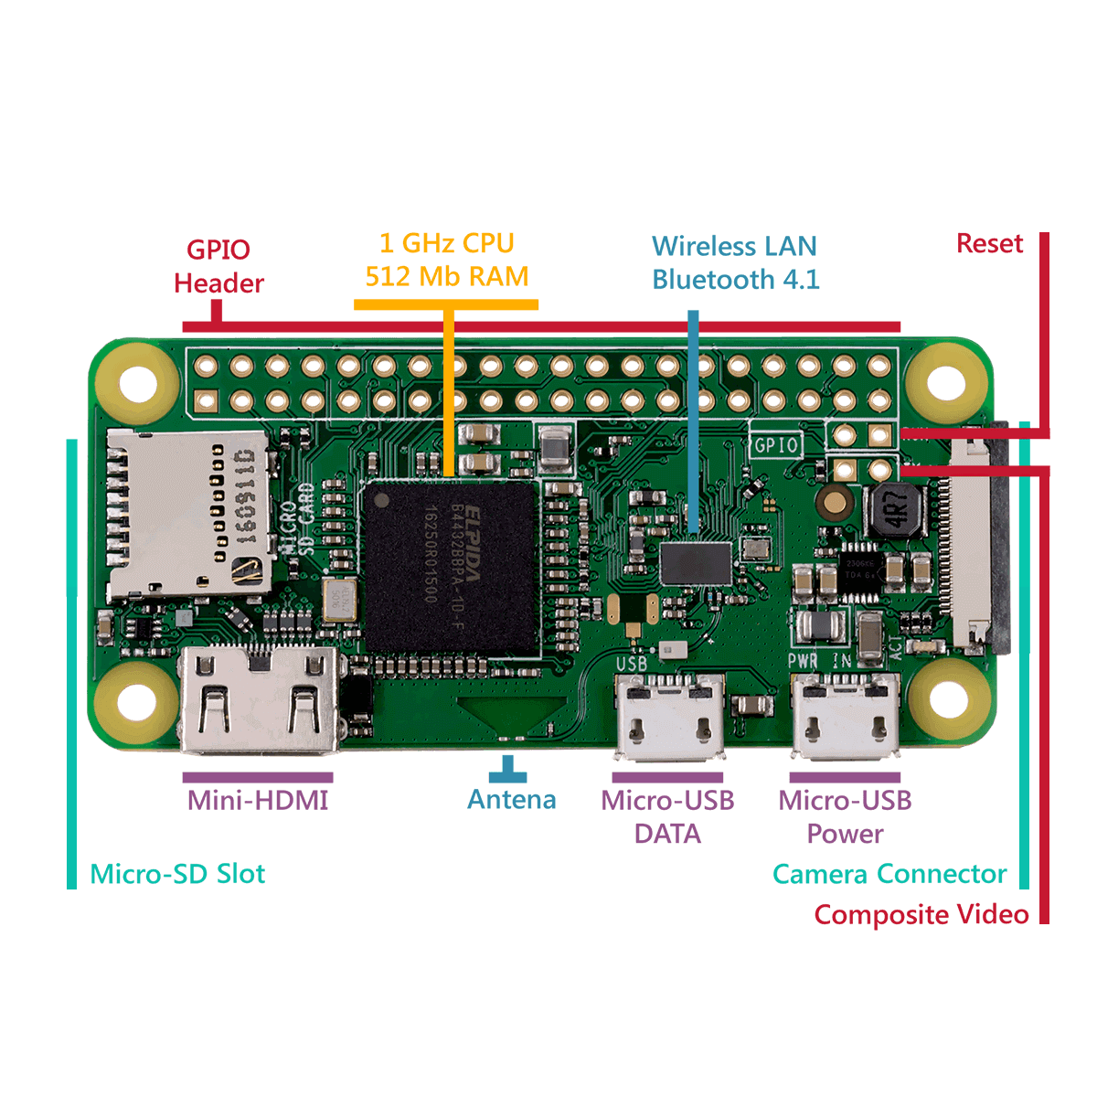

Slide 6
A few exemples
Iot
Games
Mobility
Biotech
Robotics

Slide 7
SSH and VNC
SSH
VNC
Secure Shell
Secured Communication Protocol
Remote control via terminal
Software to open a tunnel: PuTTY, Cygwin, OpenSSH
Pros: fairly transparent, immediate execution of commands
Contre: Terminal commands
Virtual Network Computing
Remote control via GUI
Eg. Technical Support
Software: VNC Viewer
Pro: Easy to use
Contre: takes a huge toll on the CPU

Slide 8
What is Python and why I should be learning it?
Interpreted (No compilation)
Object-oriented
Multi-platformed (works on almost anything)
High-level programming (Pb-Solving oriented, easy syntax)!=Assembly
Widely used in sciences, robotics, domotic => plenty of libraries & doc
Interface with most databases: great for machine-learning

Slide 9
A few examples
GIS
Air Traffic
Machine Learning
Bioinformatics
Astronomy
Trading

